Slide 1



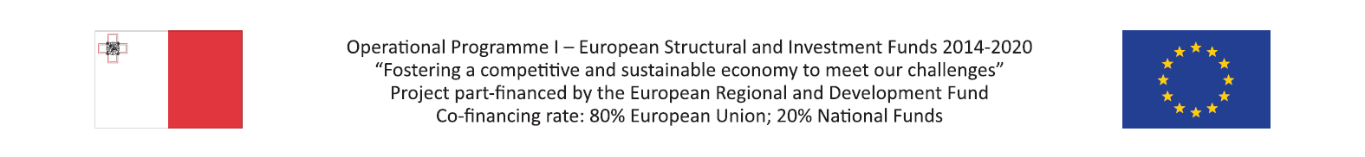
Use of e-commerce in the fashion industry
  September, 2018

Slide 2
Overview of report
Key summary
Title | Insights | Impact
Introduction | The global fashion industry is continuously moving towards a decisive phase of digital adoption by the mainstream consumer, with online sales being projected to grow rapidly, especially in emerging markets. The ease of use of various digital instruments and content has amended the consumer purchase model from a traditional one to a more complex one across both offline and online mediums. Regardless of chosen medium, consumers expect a consistent brand experience at all times. As such, it is essential that brands adopt omnichannel retailing in their business model, which allows for retailers to understand and leverage the interconnectivity between physical and digital mediums. | In many markets, consumers look to online platforms as their first point of reference, as they offer a wider variety of products, and generally provide superior customer relevance and convenience, including insight-driven marketing to seamless customer care and logistics.
Opportunities of e-commerce in fashion industry International growth Technological innovation Reduced Barriers to entry Personalisation Mobile applications | China is the main consumer of fashion with further growth being expected in Asia and e-commerce continuing to expand beyond the West. Various innovative technologies are being utilised by fashion retailers to expand their market share and increase revenues. Worldwide e-commerce fashion revenue is constantly on the rise, with significant growth being expected as a result of the elimination of international barriers to entry. Consumers are increasingly expecting to be offered personalised shopping experiences as opposed to traditional shopping. Retailers are therefore adopting data driven approaches which take advantage of data to create a personalised customer experience to ensure successful omnichannel retailing. Mobile applications serve as a key element in a company’s offerings, as users constantly seek a high engagement platform. As such, mobile applications can be seen to be a crucial innovation which strive on consumer engagement. | Due to the numerous opportunities which e-commerce provides to the fashion industry, companies are becoming increasingly able to expand into untapped markets, increase their customer base, and ultimately increase revenues.
Trending fashion retail app technologies | Fashion mobile applications are constantly being updated with innovative features which benefit both retailers and consumers. Such features are enabling companies to increase customer retention while promoting brand image. Moreover, mobile applications serve as a new medium through which additional revenue can be earned. | Companies who are able to adapt and innovate by adopting such new technologies will be considered as key players within the fashion industry.
Benefits of mobile apps for fashion retailers | The use of mobile apps has revolutionalised the fashion industry, which has brought about a number of related benefits including increased customer loyalty, enhanced brand image and efficient inventory management amongst others. | Customer focus is rapidly shifting from traditional desktops to smartphones, as consumers are becoming increasingly reliant on their smartphones to cater for their every need.
Conclusion | The ingrained role of mobile apps in consumer purchasing behaviour has cemented the fact that such apps continue to drive sales. Companies which implement customer-centric mobile app features will manage to achieve brand loyalty and increased consumer usage | The focus should now be shifted on the importance of identifying and selecting the most useful features which best represent the brand, promote customer engagement and increase revenues..

Slide 3
Section 1:
Introduction
Introduction
2. Opportunities of e-commerce in the fashion industry
3. Trending fashion retail app technologies
4. Benefits of mobile apps for fashion retailers
5. Conclusion

Slide 4
Introduction
The fashion industry in collaboration with e-commerce acts as a tool for innovation and growth and has been at the forefront for multiple technological breakthroughs. The concept of e-commerce has transformed the fashion industry, allowing consumers to shop from the comfort of their own home.
Growth in e-commerce fashion industry
E-commerce has enabled luxury fashion to be widely accessible to a worldwide market, and forms a significant part of the global economy. Research has also indicated that apparel sales on e-commerce portals have exceeded expectations, while surpassing sales in all other categories. Further growth is anticipated due to new emerging markets worldwide, with the McKinsey Global Fashion Index further projecting growth in global fashion industry sales by 4.5% in 2018.
Reliance on e-commerce platforms
Even though prominent use of online platforms continues to increase within the mainstream fashion industry, smaller brands and retailers have remained sceptical about adopting such strategies. Early adopter companies have become increasingly reliant on such online platforms to grow their business, which signifies a clear threat if these platforms become unavailable or unusable, as this would lead to a reduction in the customer base.
As the industry continues to evolve, more companies are increasingly adopting and interacting more extensively with their customers through such online platforms. This allows them to gather valuable data which can be used to better understand customer needs or to strengthen key areas within the business such as brand presentation and image.
Despite the numerous benefits which e-commerce provides for retailers, companies must ensure to position themselves strategically within the fashion market through a combination of traditional stores and e-commerce alternatives. This is due to the fact that certain customers prefer to use both mediums to shop for their preferred products, namely both online and physically through stores. By adopting an omnichannel approach, retailers would be able to take full advantage of customer preferences, thereby maximising their potential revenue.
Luxury brands are generally exclusively available through their own physical and online stores, however, smaller brands who do not have such available resources forego the use of online shops and distribute and promote their products through selected retailers.

Slide 5
Section 2:
Opportunities of e-commerce in the fashion industry
Introduction
2. Opportunities of e-commerce in the fashion industry
3. Trending fashion retail app technologies
4. Benefits of mobile apps for fashion retailers
5. Conclusion

Slide 6
Opportunities of e-commerce in the fashion industry
International growth
Over the next decade, the fashion and apparel industry is expected to undergo significant sales growth driven by an expanding global market. Worldwide experts predict that the e-commerce segment of fashion and apparel will increase at a compound annual rate of 10.6% from $481 billion in 2017 to more than $713 billion by 2022, as shown in the figure below. This growth is mainly being driven by the expansion of global markets. China is currently the primary consumer of fashion as evidenced by revenue, however further growth is expected in Asia due to increased global online access and smartphone penetration.
Fashion industry worldwide total revenue
Source: Statista
Much has also been made of fashion’s new global landscape, with e-commerce continuing to expand further beyond the West. Accordingly, China, the United States and United Kingdom rank as the three largest e-commerce markets globally, with revenues of $672, 340 and $99 billion respectively. Moreover, purchasing rates are constantly on the rise, with fashion products being the most in demand. This is reflected through the consistent use of online e-commerce globally, with 77% of South Korean and 76% German customers using online platforms to carry out their shopping needs.
Fashion industry global e-commerce usage
Source: Statista

Slide 7
Opportunities of e-commerce in the fashion industry (…cont)
E-commerce clothing segment worldwide revenue
Source: Statista
E-commerce fashion industry expected growth
Source: Statista
Technological innovation
In already established and developed markets, sellers will increasingly strive to drive growth through the use of artificial intelligence (AI), machine learning, and e-commerce automation tools that offer relevant and highly personalised customer experiences. A number of innovative technologies also exist which create experiential e-commerce. These include virtual fitting rooms and AI-powered virtual shopping assistants which are closely aligned with consumers’ tastes and preferences. Moreover, many fashion companies are increasingly making use of mobile applications to promote and sell their products through new online platforms. This signifies the ever increasing mobile adoption rates, which has prompted the digital transformation age.
Barriers to entry
Lower digital barriers to entry for all clothing sellers increasingly offer the opportunity for merchants to market and sell products internationally and automatically. As a result of this change, worldwide revenue is projected to grow significantly. In fact, from 2017 to 2022, the compound annual growth rate (CAGR) is projected to be 8.8%, 8.7% and 14.1% in the United States, Europe and China respectively.

Slide 8
Opportunities of e-commerce in the fashion industry (…cont)
Personalisation
Personalisation is a leading factor in the e-commerce industry, with 75% of consumers preferring to receive personalised offers and messages from their preferred brands. Moreover, 94% of companies view personalisation as being critical to achieve current and future success. By tracking user behaviour, fashion sellers can integrate user personalisation within the site itself, thereby targeting individual customers rather than a broad market. In the near future, shoppers will increasingly expect to experience this type of personalisation in the e-commerce fashion industry. Furthermore, situational targeting is another viable option which is being recommended by e-commerce experts. Situational targeting is a method whereby a variety of data is collected about consumers which is used to target specific customers through the use of personalised marketing and offers. As such, AI automation is a useful tool through which this process can be facilitated.
Mobile applications
The pervasiveness of mobile phones across all industries allows companies to further engage shoppers at any time from any place. The adoption of mobiles is rapidly approaching saturation, which indicates that it is a high engagement platform. A well-implemented mobile feature allows brands to complement their primary products, especially for the most brand loyal customers who are more likely to regularly use the app.
Mobile engagement can reinvigorate stale brands if customers are engaged in new ways. Companies that are willing to utilise highly technological features such as AI or virtual reality (VR), are more likely to become trendsetters in their respective industries which may have a spill-over effect in other markets.
In order for a mobile app to garner meaningful and regular usage, it must be considered as simply one instrument in a brand’s digital footprint. Increased sales is still considered to be the ultimate goal of a mobile app’s accomplishments. However, discovery and subsequent engagement, and consequent customer retention, are considered to be the prerequisites to the achievement of sales in the feedback loop. A personalised after sales experience is just as important for customer satisfaction, as consumers increasingly require peace of mind when shopping online.
Mobile app objectives
Discovery
Engagement
Sales

Slide 9
Section 3:
Trending fashion retail app technologies
Introduction
2. Opportunities of e-commerce in the fashion industry
3. Trending fashion retail app technologies
4. Benefits of mobile apps for fashion retailers
5. Conclusion

Slide 10
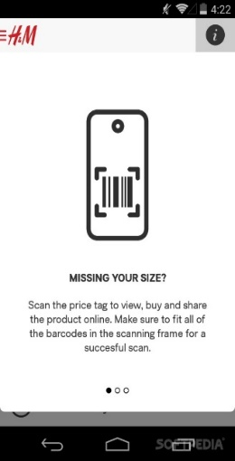
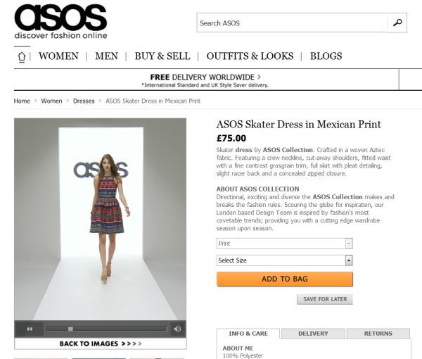
Trending fashion retail app technologies
    Leading fashion retailers such as ASOS, H&M and Dior are implementing a number of innovative technologies to enhance their shopping experiences and offer innovative solutions to remain at the forefront of the industry. These technologies can also be easily exploited by smaller companies to gain a foothold within an ever increasing competitive market.
Fashion retail app technologies
Technologies | Details | Examples
Barcode scanners | Through an ingrained barcode scanner within the app itself, consumers are able to scan product barcodes to easily obtain product details, which helps in lowering prices. H&M has successfully implemented this technology, which provides multiple opportunities for customers to obtain coupons and discounts in addition to identifying store locations. Through an analysis of scanned products by shoppers, the app can also recommend coupons which are tailored specifically to customers.
Selling products with videos | Online shopping has adopted a new direction with regards to product displays. Online stores are increasingly featuring products by showcasing catwalk videos for every product. This technique can be seen to enhance brand trust and promote products more effectively. The 360-degree videos generally help customers in making informed purchasing decisions, in addition to providing product piece of mind.

Slide 11
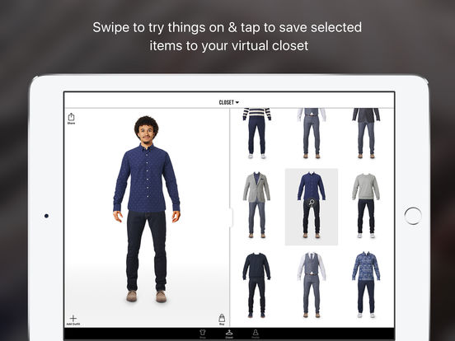
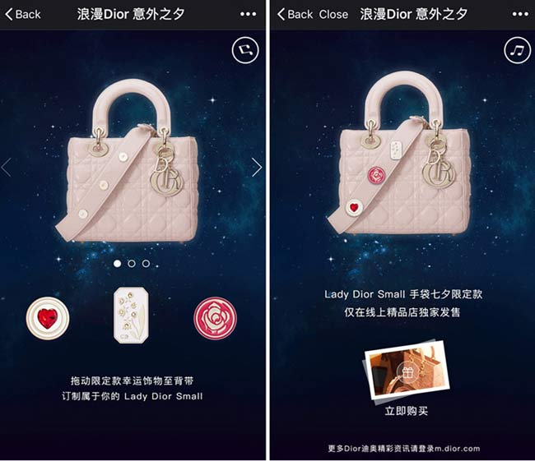
Trending fashion retail app technologies (…cont)
Fashion retail app technologies
Technologies | Details | Examples
Virtual reality outfits | Through the use of virtual dressing rooms, retailers can afford to reduce costs relating to the availability of physical shop space, as customers can try on outfits virtually. This allows for added flexibility to the customer shopping experience, through the availability of different colours, patterns and sizes. Through the Klothed app, users can create custom avatars by uploading personal photos, whereby they can try on different items of clothing from various retailers, which aids in reducing the amount of online returns.
Social selling | Retailers are increasingly taking advantage of social networks to further promote their products. Social media has successfully managed to infiltrate the luxury retail market, which enables retailers to engage more effectively with their customers. Multiple brands are collaborating with technology leaders in the industry to promote and sell products via social platforms such as Facebook and WeChat. Dior was one of the first players to partake in social selling in order to engage customers in China through WeChat, which enabled it to achieve phenomenal sales.
Beacons | Another trend is beacon technology which plays a crucial role in improving the customer shopping experience. Customer engagement will be enhanced through retailers communicating with customers in a more personalised way. These beacons will be installed by retailers in stores, which will be used to communicate directly with consumers’ apps. When shoppers are within range of the beacon, they are alerted to deals, exclusive offers, and loyalty points, amongst others. A number of major brands such as Urban Outfitters and Macy’s have already adopted such technologies, which has provided customers with the opportunity of being notified about seasonal sales and winning event prizes through the use of push notifications.

Slide 12
Section 4:
Benefits of mobile apps for fashion retailers
Introduction
2. Opportunities of e-commerce in the fashion industry
3. Trending fashion retail app technologies
4. Benefits of mobile apps for fashion retailers
5. Conclusion

Slide 13
Benefits of mobile apps for fashion retailers
    With the smartphone apps mentioned in the previous slide and other apps on the market, the fashion industry is on the verge of transformation as customer focus is increasingly shifting from traditional desktop to smartphone screens. These apps will transform fashion retail in a number of ways, and provide a number of benefits to fashion sellers:
Mobile apps benefits for fashion retailers
Benefits | Details
Customer loyalty | Apps are essential if companies wish to retain customer loyalty. Apps can be a worthwhile investment as they help in bringing repeat customers, since consumers are more likely to refer to the app if a sudden need arises.
24/7 access to audience | Discovery platforms such as these apps provide the ideal medium through which brands can gain a feel towards potential new products or ideas online, without incurring any related production costs. Fashion conscious consumers have the ability to provide instant feedback on any new products or offers, which allows retailers to deliver goods to the market in the quickest and most cost-effective way possible.
Increased brand/image | By offering services through mobile apps, businesses can prove to customers that they are cutting-edge, which further strengthens brand appeal. This can be especially useful for new and emerging fashion sellers wishing to increase their presence on the market, as opposed to traditional marketing channels.
Inventory management | Through the digitisation of a company’s entire catalogue, inventory management can become streamlined and automated, which allows companies to prepare in advance for any unexpected increases in demand, thereby making stock maintenance more efficient.
Access to niche markets | By developing and adopting mobile apps, businesses that deal with used designer goods and factory outlet goods can offer their services through such apps, thereby catering to niche markets and increasing revenues.
Increased revenue | Big data emanating from fashion apps can assist brands in recommending similar products or styles to consumers through in-app purchases, which acts as a new medium through which additional revenue can be earned. Although big data for retail is evidently effective and reliable, a definite cost advantage exists in foregoing the human element in personal shopping apps. These apps can reliably build a level of confidence and trust with consumers in the luxury market, especially for those who are highly demanding and time-sensitive.

Slide 14
Section 5:
Conclusion
Introduction
2. Opportunities of e-commerce in the fashion industry
3. Trending fashion retail app technologies
4. Benefits of mobile apps for fashion retailers
5. Conclusion

Slide 15
Conclusion and recommendations
  Conclusion
  The cases reviewed in this report make it clear that the use of e-commerce within the fashion industry provides numerous benefits for retailers wishing to increase their client base by expanding into new markets. E-commerce provides a viable alternative to traditional physical stores, which helps minimise inventory, reduce costs, and build brand loyalty. Even though the adoption of e-commerce may be seen as a risky investment for smaller Maltese companies who may not have the same level of resources as international larger brands, such companies can still implement online platforms within their business models albeit on a smaller scale. This will allow them to also benefit from the associated advantages which e-commerce offers, in addition to differentiating themselves from competitors.
  Both international big brands and smaller local companies in Malta appropriately fit within the value chain, as they both contribute extensively to new innovations within the fashion industry. The ever present e-commerce developments have increasingly allowed fashion companies both big and small to exploit their full potential within the market.
  Recommendations
  In order to promote and sustain e-commerce growth and usage, a number of schemes are available both locally and internationally. For instance, the Maltese e-commerce grant scheme has been introduced with the aim of encouraging enterprises to increase their presence within their respective industries. This can be achieved by implementing e-commerce through online sales in their operations.
  Moreover, statistical data indicates that the majority of Maltese companies are not taking advantage of the island’s potent IT infrastructure, particularly with regards to facilitating internationalisation efforts for interested entities. Through the successful adoption of e-commerce, fashion retailers specifically can expand their operations internationally, which encourages them to adopt a more innovative mind-set, in addition to providing increased employment opportunities.

